Slide 1
Recommender Systems

Slide 2



Slide 3
What movie should we watch?
3

Slide 4



3 Datasets
28 million reviews
54 thousand movies
280 thousand unique reviewers
45 thousand movies tagged

Slide 5
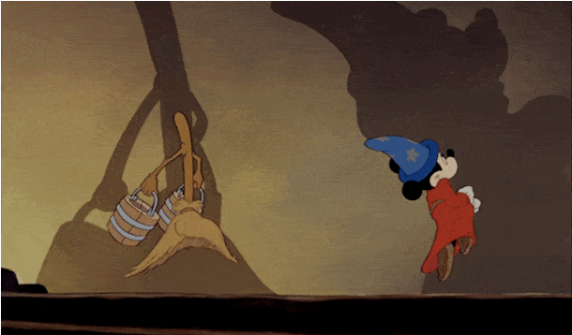
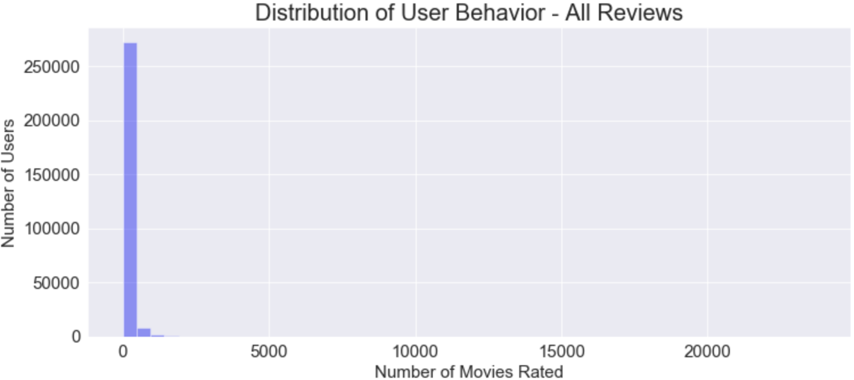

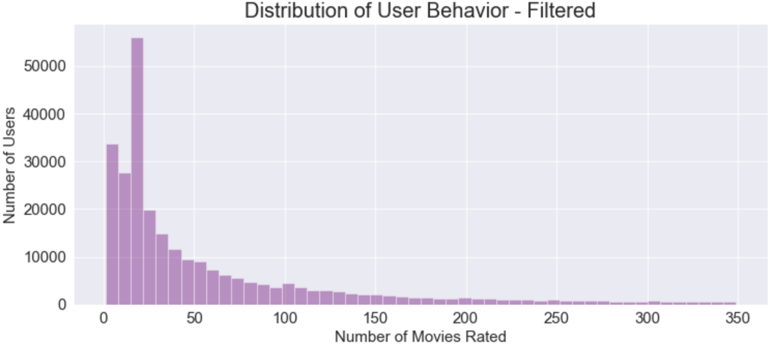

Cleaning rating Data (1)
28 Million Reviews
Movies rated 5 or more
Outlier Reviewers: Median + 4 STD reviews
Top 17,000 people review 12 million movies at a rate of 700 reviews p/person
14 Million Reviews
5

Slide 6

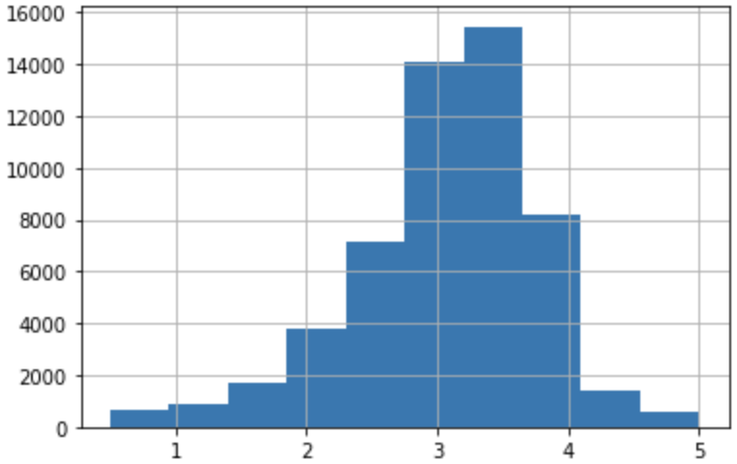

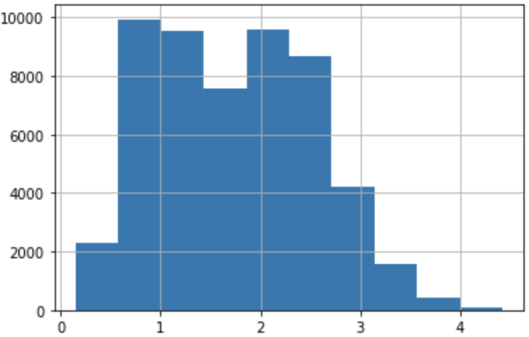
Movies AVG rating
Cleaning rating Data (2)
Penalizes less rated movies
Weighted Mean Rating = Mean Rating * Percentile weights
Weights = All ratings per movie percentiles (10 different weights)
Movies AVG rating Weighted

Slide 7


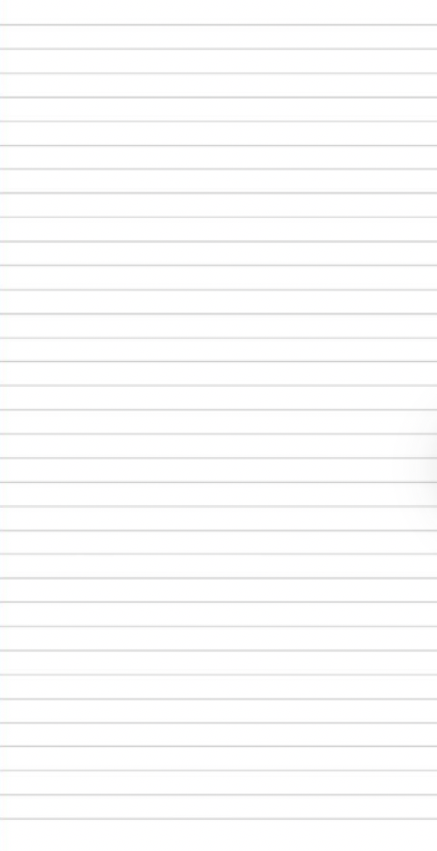
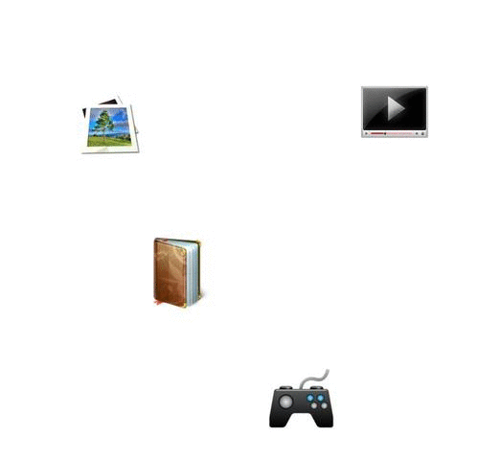
Collaborative Filtering
Approach:
Pearson Correlation
Truncated SVD
Neural Network trained embedding
Movies and Ratings

Slide 8

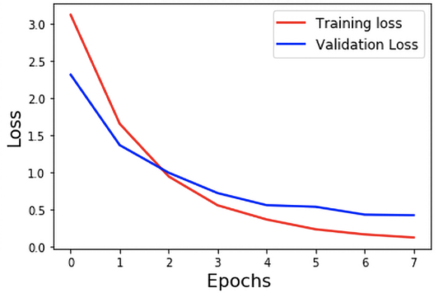
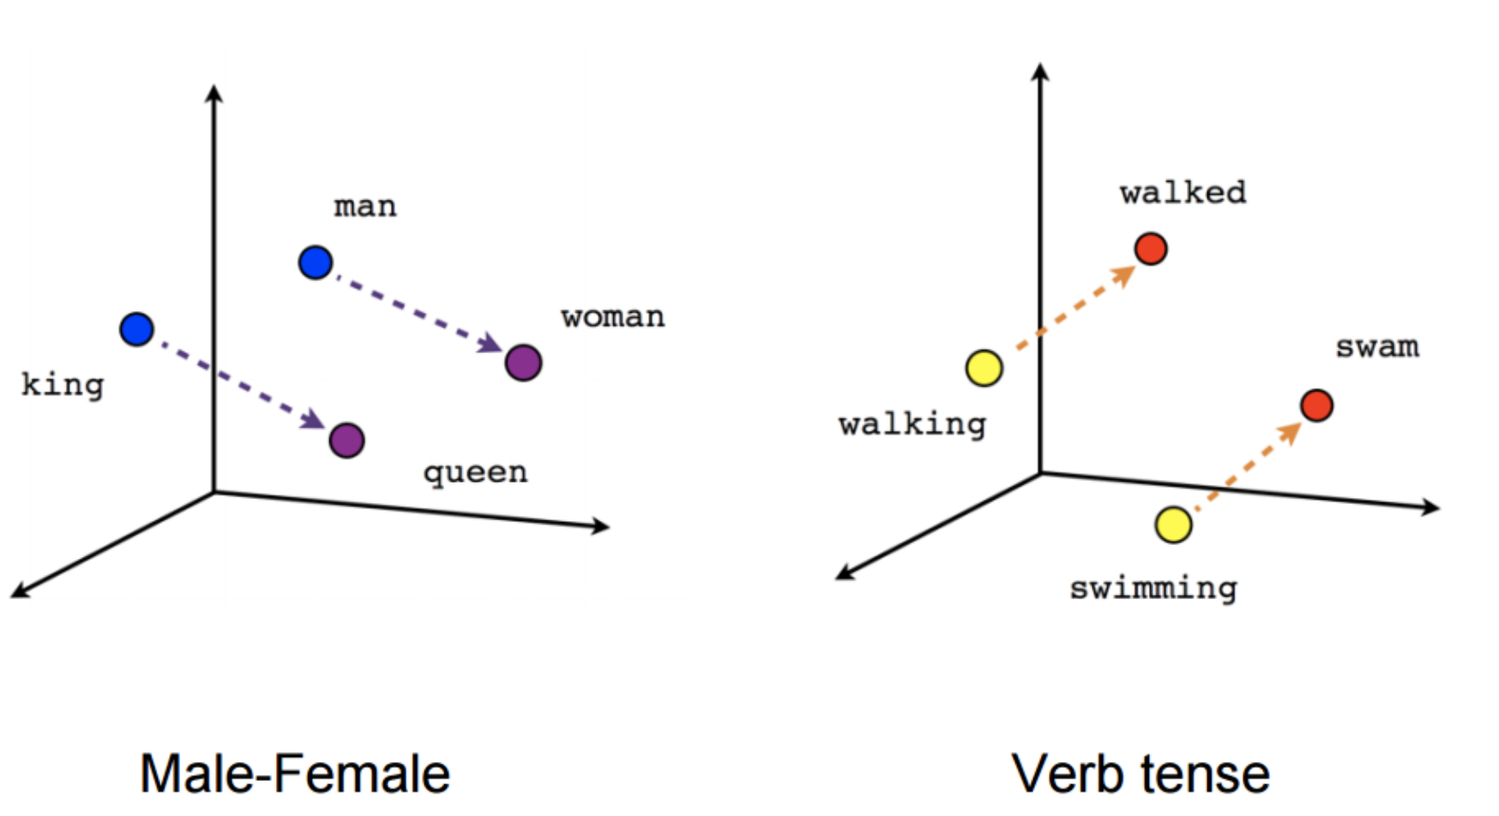
Neural Network embeddings
Embedding weights trained such that the dot product of two vectors approximates the output (rating – mean rating) at each iteration.
18 million Movie - Rating combinations mapped into a latent space (32 dims)

Slide 9


Content Based
Movie
Genres
Tags
ratings

Slide 10
Approach
Preprocess text
+ BOW(TFIDF)
+
Filter top 1% uncommon words
Cosine Similarity vector result
Similarity sorted + weighted rating
New Feature combining genres and tags

Slide 11



